Slide 1




MoviesHuB
An Ad-Free OTT Streaming Platform

Slide 2
Team Members
Khushi Gedam
Kamran Dhopaunkar
Advait Jadhav

Slide 3
Introduction
MoviesHuB is a next-generation streaming platform designed to provide users with seamless, ad-free access to movies and TV shows from OTT services like Netflix and Amazon Prime.
The platform leverages cloud-native technologies, integrating React.js for a dynamic UI, Firebase for backend services, and AWS S3 for scalable hosting and deployment to ensure high availability and smooth performance.
MoviesHuB features real-time content updates, personalized recommendations, and robust security, including AWS IAM for secure access, AWS Shield for DDoS protection, and AWS CloudTrail for security monitoring, making it a secure, scalable, and uninterrupted entertainment hub. 🎬🚀

Slide 4
Platform Overview
MoviesHuB is a cloud-powered streaming platform that provides users with ad-free access to a vast collection of movies and TV shows from popular OTT services like Netflix, Amazon Prime, and more.
The platform is built using React.js for a dynamic UI, Firebase for backend management, and AWS S3 for hosting and deployment, ensuring high availability, scalability, and seamless performance.
With real-time content updates, personalized recommendations, and strong security protocols (AWS Shield, AWS CloudTrail), MoviesHuB delivers a secure, scalable, and uninterrupted streaming experience for users worldwide. 🎬🚀

Slide 5
Technology Stack
🖥️ Frontend: React.js (Dynamic UI, SPA)
⚙️ Backend: Node.js (API, business logic)
💾 Database: Firebase Realtime Database (User & content management)
🔐 Authentication: Firebase Auth (Email/Google OAuth)
☁️ Hosting & Deployment: AWS S3 (Scalable content delivery)
🛡️ Security: AWS Shield (DDoS protection), AWS CloudTrail (Monitoring)

Slide 6
Key Features
🎬 Ad-Free Streaming – Enjoy uninterrupted movies & TV shows from multiple OTT platforms.
🚀 Cloud-Powered Performance – Hosted on AWS S3 for high availability & scalability.
🔐 Robust Security – AWS Shield, and CloudTrail ensure secure access & protection.
📡 Real-Time Updates – Dynamic content updates & personalized recommendations.
🛠 User Authentication – Secure login via Firebase Auth (Email/Google OAuth).

Slide 7
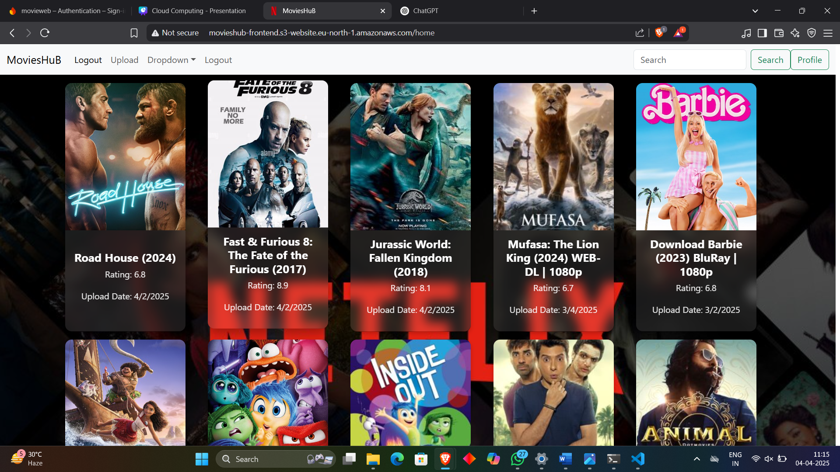
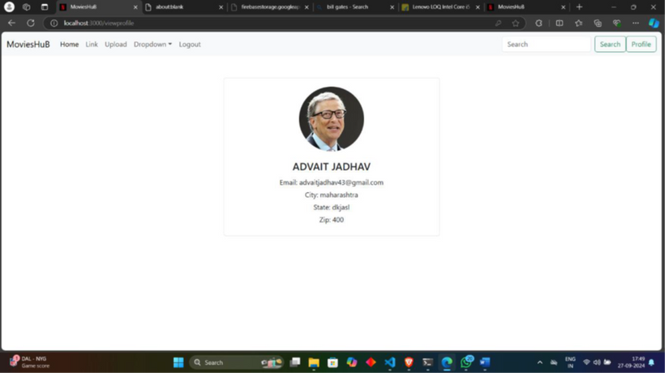
User Experience Design
MoviesHuB provides an intuitive navigation. It offers minimal steps to content discovery, and personalized user profiles. Easily switch between streaming services.

Slide 8
Technical Architecture
1️⃣ Frontend (React.js) – Handles UI, user interactions, and dynamic content rendering.
2️⃣ Backend (Node.js & Firebase) – Manages API requests, authentication, and real-time updates.
3️⃣ Database (Firebase Realtime Database) – Stores user data, content metadata, and preferences.
4️⃣ Hosting & Deployment (AWS S3) – Ensures scalable and efficient content delivery.
5️⃣ Security Layer –AWS Shield (DDoS protection), and AWS CloudTrail (Activity monitoring).

Slide 9
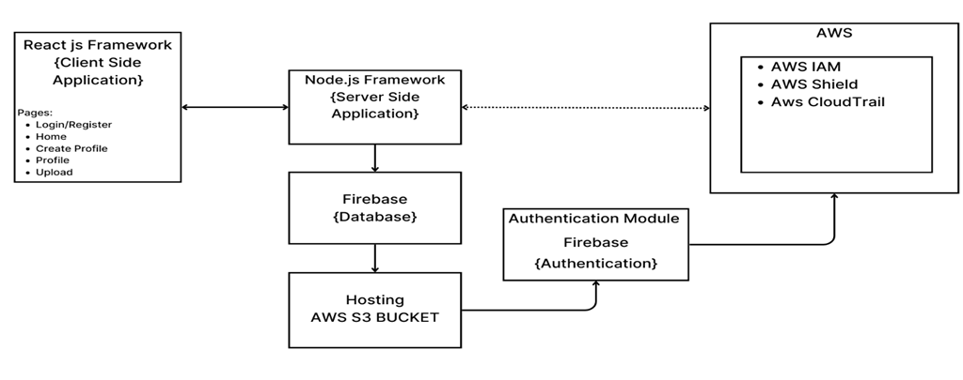
System Architecture

Slide 10
Security Considerations
🔐 Secure Access Control (AWS IAM) – Role-based permissions ensure least-privilege access.
🛡 DDoS Protection (AWS Shield Standard) – Protects against malicious traffic and attacks.
📊 Monitoring & Compliance (AWS CloudTrail & Security Hub) – Tracks user activity, API calls, and security threats.
🔑 Encrypted Authentication (Firebase Auth) – Secure login with Email/Google OAuth.
🔒 Data Protection (HTTPS & Firebase Security Rules) – Ensures encrypted communication and access control.

Slide 11
Future Roadmap
🚀 Expand Content Library – Integrate more OTT platforms for a wider selection of movies & shows.
📱 Mobile App Development – Launch Android & iOS apps for seamless streaming on the go.
🤖 AI-Powered Recommendations – Enhance personalization using machine learning algorithms.
🌎 Global CDN Integration – Improve streaming speed & reduce latency worldwide.
🔐 Enhanced Security – Implement zero-trust security model for better data protection.

Slide 12
Conclusion
MoviesHuB is a cloud-powered streaming platform designed to offer a seamless, ad-free entertainment experience. By leveraging React.js, Firebase, and AWS services, it ensures scalability, security, and high performance. With real-time content updates, personalized recommendations, and robust security measures, MoviesHuB stands as a reliable and future-ready entertainment hub. As the platform evolves, enhancements like AI-driven recommendations and mobile app development will further elevate the user experience.

Slide 13
Thank You

